Slide 1
Prioritizing Agency Needs
Lakewood Resource & Referral Center
212 Second Street, Suite 204
Lakewood, New Jersey 08701

Slide 2
The Topics We’ll be Covering
Prioritizing Agency Needs
Setting The Goals
Developing the Tasks
Categorizing the Tasks
The Impact of Time
Prioritization Techniques

Slide 3
The Framework

Slide 4
The Framework
Setting The Goals
Developing The Tasks
Categorizing the Tasks
The Impact of Time

Slide 5
The Framework
Setting The Goals
2 Points
1
2
SMART Goals
Vision
Mission
S
Specific
Goals
M
Measurable
A
Attainable
R
Realistic
Values
T
Time Based

Slide 6
The Framework
Developing the Tasks
6 Questions
What?
Where?
Lowest Input
for
Maximum Output
When?
Why?
Who?
How?

Slide 7
The Framework
Categorize the Tasks
Dependent Tasks
Independent Tasks
Inter -dependent Tasks
Determined by another Task
Self
Sufficient
Mutually Dependent

Slide 8
The Framework
The Impact of Time
A defined window of opportunity to accomplish Tasks
Not Everything can Get Done
What Goes First?
What Goes Last?

Slide 9
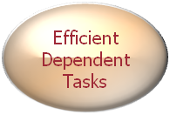
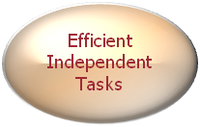
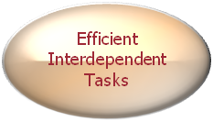
The Framework
Summing it up.
Goals – Within the Framework of the Mission, Vision and Values
Time
Tasks – Structured Efficiently, To achieve those Goals
Goals
Category – Categorize tasks as Dependent, Independent or Interdependent
Tasks
Time Restriction – The Tasks are all Restrained by limited Time

Slide 10
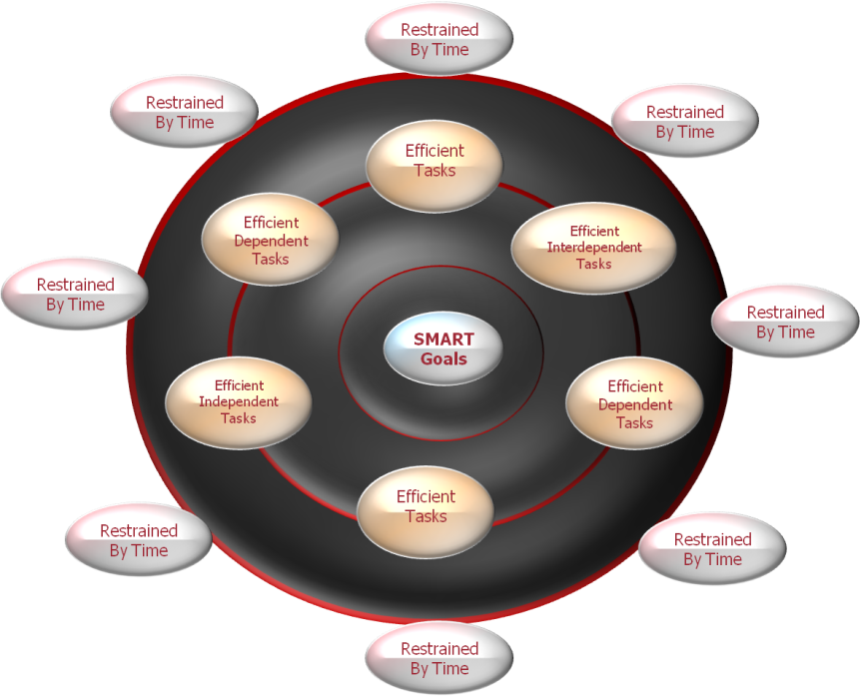
What the Framework Looks like
Summing it up.
Only 50% of Tasks will be accomplished
Their Characteristics Vary
Which Tasks take Precedence
Efficient Tasks
Efficient Interdependent Tasks
Efficient
Dependent Tasks

Slide 11
Techniques for Prioritizing

Slide 12
How to Prioritize…
Pareto Principle
Six Techniques
Covey’s Quadrants
Paired Comparison Matrix
Action Priority Matrix
Carver Matrix
Triage

Slide 13
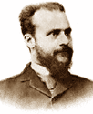
Pareto Principle
80% of the Italian Wealth
was distributed to
20% of the Population
Unequal distribution of efforts
as they relate to impact
Vilfredo Pareto

Slide 14
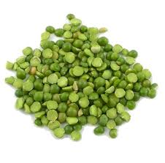
Pareto Principle
80/20 Rule
20% of the Pods
Produce
80% of the Peas
Unequal distribution of results as they correlate to efforts

Slide 15
Pareto Principle
20% of the input creates 80% of the result
Focus on the 20% that counts
20% of the Donors donate 80% of the Donations
Other Areas -
80/20 Rule
20% of the customers create 80% of the revenue
20% of the features cause 80% of the usage

Slide 16
Pareto Principle
Summing it up.
80/20 Rule
Uneven Distribution of efforts vs. Outputs
Identify the 20% that impacts most
Focus resources towards it

Slide 17
Covey’s Quadrant’s
Organize and Execute
around Priorities
The Four quadrants
that all tasks fit into
Stephen R. Covey

Slide 18
Covey’s Quadrants
Important vs. Urgent
Urgent
Not Urgent
Important
Quadrant 1
Quadrant 2
Not Important
Quadrant 3
Quadrant 4

Slide 19
Covey’s Quadrants
What gets higher Priority?
QII is allocated the highest priority
Urgent
Not Urgent
Quadrant 1
Quadrant 2
Important
Crisis
Prevention
QI gets taken care of First, But of Lower Priority than QII
Quadrant 3
Quadrant 4
Not Important
Interruption
Trivia

Slide 20
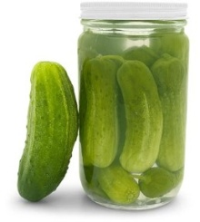
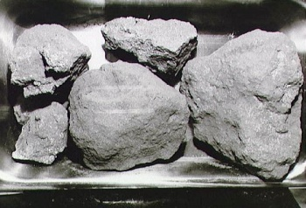
Covey’s Quadrants
What goes first?
Urgent
Not Urgent
Quadrant 1
Quadrant 2
Important
Quadrant 3
Quadrant 4
Not Important

Slide 21
Covey’s Quadrants
Summing it up.
All Tasks fit into Four Quadrants
Priority is given to Quadrant II
Quadrant I gets immediate attention
Pickle Jar – Fill to Maximum Capacity

Slide 22
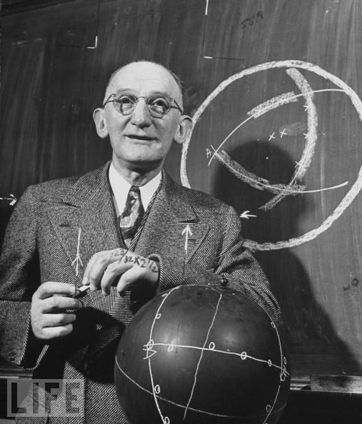
Paired Comparison Analysis
Law of
Comparative Judgment
Weighing Options in pairs
L. L. Thurstone
Identifying which option
in the pair is preferred

Slide 23
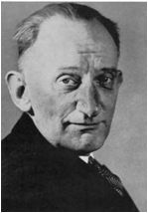
Paired Comparison
Paired Comparison Analysis
Listing The Tasks
A
B
C
Weighing them against each other
A
B
Calculating the Task Values
C

Slide 24
Paired Comparison
Values
Scores
Option A
Option B
Option C
A = 3
B = 2
C = 1
Option A
A3
C1
Option B
B2
A = 50%
B = 33.5%
C = 16.5%
Option C

Slide 25
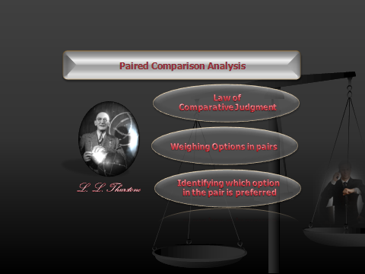
Paired Comparison
Summing it up.
Create a list of Tasks
Weigh Tasks against each other in Pairs
Assign Relative Values to Tasks
Focus on the Highest Value Tasks First

Slide 26
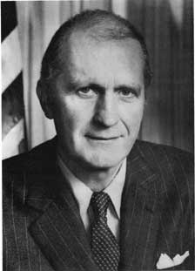
Action Priority Matrix
Compares Priorities
across multiple areas
Categorizes Tasks as a tradeoff
between effort and Impact
Malcolm Baldrige

Slide 27
Action Priority Matrix
Effort vs. Reward
Listing The Tasks
Determining the Efforts and Impact
Plotting it down on a graph

Slide 28
Action Priority Matrix
High/Low, Effort/Impact
10
High Impact, High Effort
High Impact, Low Effort
Impact
Low Impact, Low Effort
Low Impact, High Effort
1
Effort
10

Slide 29
Action Priority Matrix
Summing it up.
Plot Graph With Task’s Effort/Impact Level
Split Graph into Quarters
Focus First on
Low Effort/High Impact
Low Priority to Low Impact Tasks

Slide 30
CARVER Matrix
Ranks Tasks against
each other Using 6 Criteria
Assists in the allocation
of limited resources
Special Operations
Command

Slide 31
CARVER Matrix
CARVER
C
Critical
A
Accessible
R
Return
V
Vulnerable
E
Effects
R
Recognizable

Slide 32
CARVER Matrix
C
A
R
V
E
R
Total
Option A
2
3
5
4
3
3
20
Option B
1
4
2
1
1
2
11
Option C
4
3
4
2
3
5
21
Option D
2
1
4
5
5
1
18
Option E
2
5
2
1
4
5
19

Slide 33
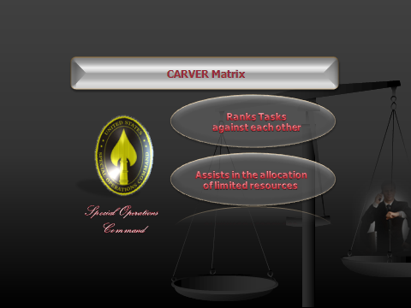
CARVER Matrix
Summing it up.
Rank Tasks For Each Perspective of CARVER
Tally up Overall Scores
Highest Score Gets Highest Priority
Lowest Score Gets Lowest Priority

Slide 34
Triage
Used to Prioritize in
Medical Crisis
A System for allocating
limited resources
Dominique Jean Larrey

Slide 35
Triage
TRIAGE
A Three Tier System for Crisis Management
Tier 1
Cannot Survive
Ignore For Now
Tier 2
Will Only Survive with Help
Attend to Now
Tier 3
Will Survive without Help
Ignore for now

Slide 36
Triage
TRIAGE
Medicine
Time Management
Available Resources inadequate to assist
1
Available Resources inadequate to Impact
Available Resources able to assist
2
Available Resources able to Impact
Available Resources Unnecessary to assist
3
Available Resources Unnecessary to Impact
Gets Ignored
Gets Highest Priority
Gets Ignored

Slide 37
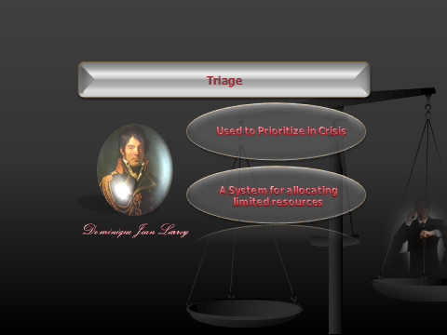
Triage
Summing it up.
Used to Allocate Limited Resources
Three Tiered System
Highest Priority assigned to tasks that can impact with available resources
Ignore all Others

Slide 38
Summing it all up….
The Framework
Prioritizing the Tasks
Pareto Principle
SMART Goals
Covey’s Quadrants
Efficient Tasks
Paired Comparison Analysis
Categories of Tasks
Action Priority Matrix
The Impact of Time
CARVER
Triage

Slide 39
Thank You.
Q&A

